Slide 1
An Exploratory Data Analysis on the Aspiring Mind Employment Outcome (AMEO) 2015 study from AMCAT
By
Shreya Ranjankar

Slide 2
About AMCAT
AMCAT, known as Aspiring Minds Computer Adaptive Test is an AI-based computer adaptive test which evaluates job applicants on critical areas like communication skills, logical reasoning, quantitative skills, and job-specific domain skills thereby helping recruiters identify the suitability of a candidate for different job roles.

Slide 3
Analysis objectives
Following the study conducted in 2015 the AMCAT team were able to gather concrete data with which they hoped to understand what has become of candidates since they took part in the tests and find interesting patterns from the study.
This analysis breaks down the objectives into two:
Univariate and Bivariate analysis of variables
Answers and conclusions to relevant hypothesis or questions.

Slide 4
Analysis Workflow
Understanding the data – initial exploratory data analysis
Data cleaning and transformation
Univariate analysis – Visual and non visual analysis
Bivariate analysis
Solutions to hypothesis or questions
Conclusion

Slide 5
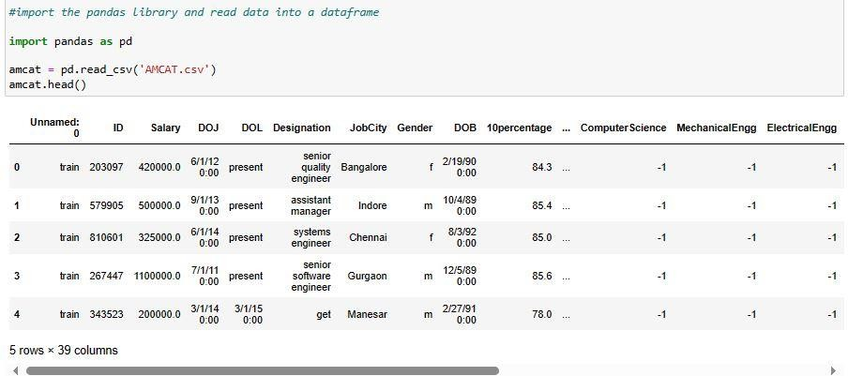
Understanding the data
This shows a view of the first five elements of the data.

Slide 6
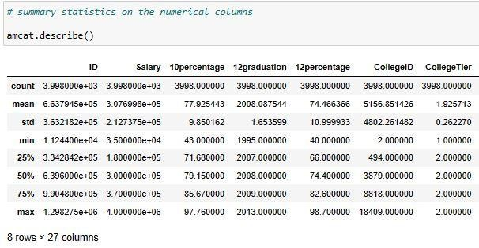
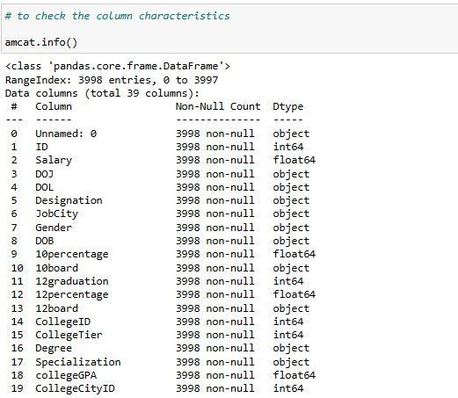
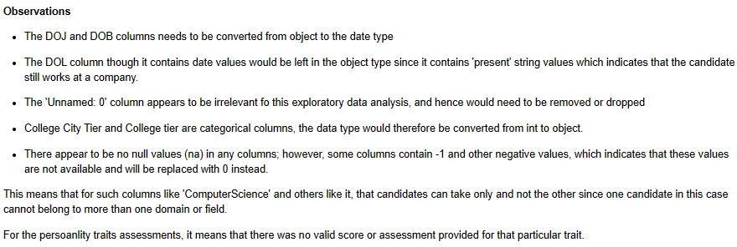
Understanding the data
Snapshots of initial exploratory analysis to understand the data

Slide 7
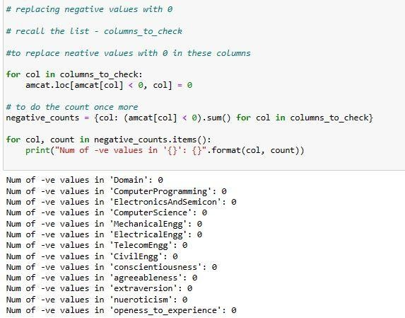
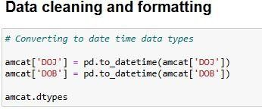
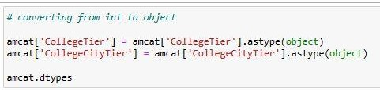
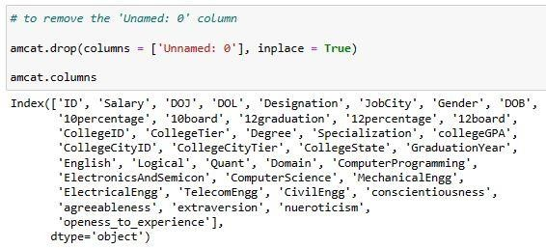
Data Transformation
Data cleaning and transformation steps

Slide 8
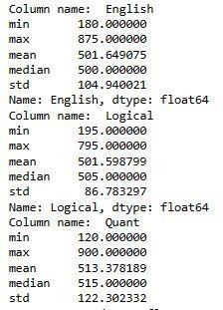
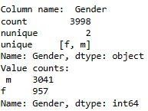
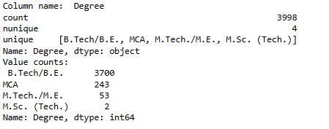
Univariate analysis –non visual analysis
In the study conducted, there were more candidates with a B.Tech/B.E and very few with an M.Sc. Analysis showed that the males were in greater number that year. Also, it shows relevant statistics of the test scores for candidates in the English, Quant and Logical sections.

Slide 9
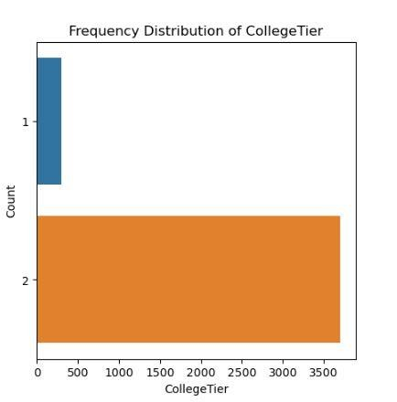
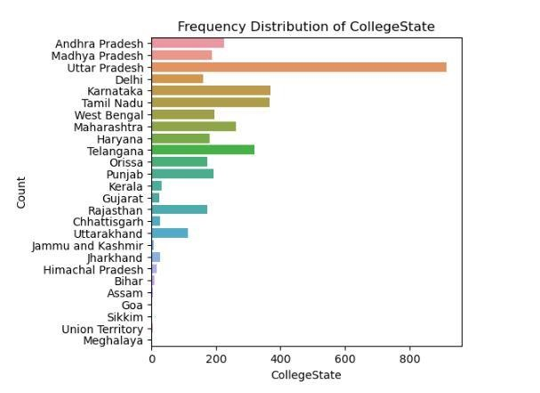
Univariate analysis – visual analysis
The College City Tier refers to the tier of the city in which the college is located. I found that most candidates are from the College city Tier tagged O while a few of them are from the tier
Most candidates attended the Colleges in Uttar Pradesh state. Following that are Karnataka and Tamil Nadu states as the next state where most candidates attended college.

Slide 10
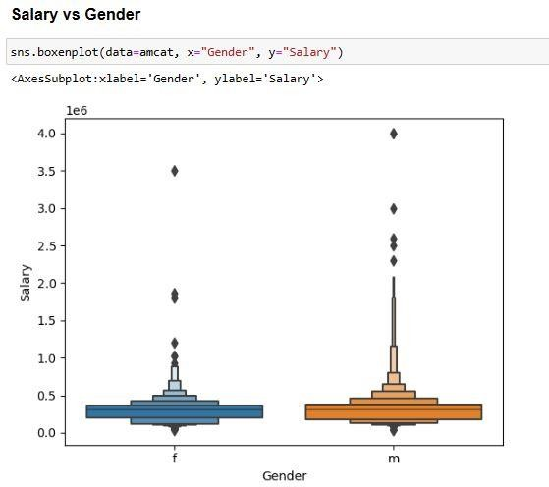
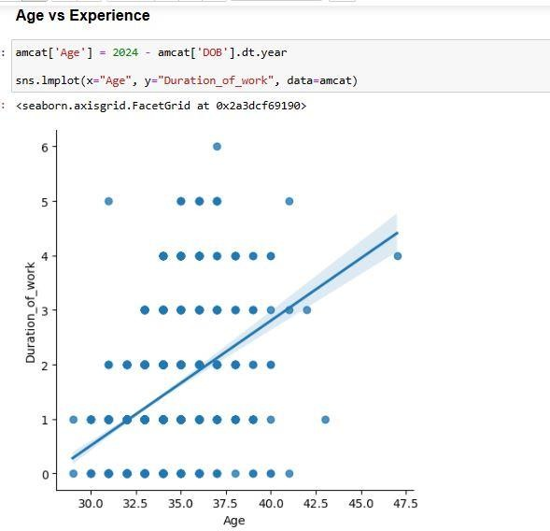
Bivariate analysis
From the plot, it is seen that the distribution of salary for males is higher, which also means they earn more. But as we saw in earlier analysis, the number of males to females in this study is unequal. Also, the plot shows a relationship between the age of duration(length) of work for participants.

Slide 11
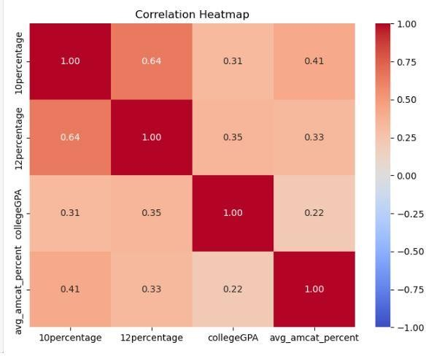
Is there a correlation between college GPA and AMCAT scores?
The correlation between collegeGPA and AMCAT scores (avg_amcat_percent) is 0.22 which is relatively small and shows very little association between the college GPA of the candidate and his/her AMCAT scores.

Slide 12
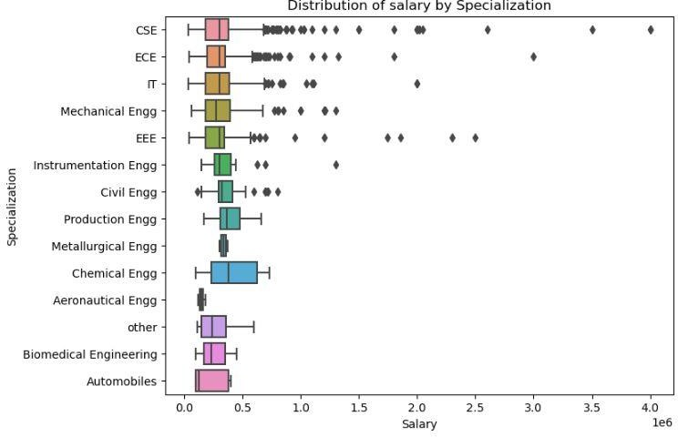
What specialization earns more salary?
Chemical engineering has a wider spread of salary range.
Computer Science (CSE) has the most outlier cases - larger salary cases compared to other fields.
Aeronautical engineering and Metallurgical Engineering had the least spread of salary ranges
Production and Chemical Engineers have the highest median salary amongst the different specializations

Slide 13
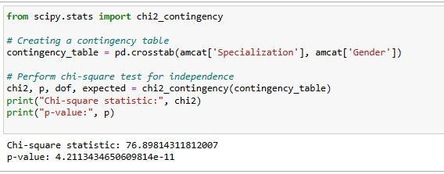
Is there a relationship between gender and specialization?
Since the p-value (4.21e-11) is much smaller than the typical significance level of 0.05, I reject the null hypothesis - H0: Gender and specialization are independent.
Therefore, I conclude that there is a significant relationship between gender and specialization in
the data provided

Slide 14
Conclusion
Following the insights generated from my analysis, I can make the following conclusions:
In the 2015 study, there were more male candidates compared to the female candidates who took part in the tests.
The maximum scores for each AMCAT test section was 900. A perfect score was achieved in the Quant section alone with the highest scores in the English and Logical section being 875 and 795 respectively.
There is little correlation or association between a candidates college GPA and AMCAT scores.
Production and Chemical Engineers have the highest median salary amongst the different specializations.
Most candidates attended the Colleges in Uttar Pradesh state. Following that are Karnataka and Tamil Nadu states as the next state where most candidates attended college.

Slide 15
T HANK YOU

